Slide 1

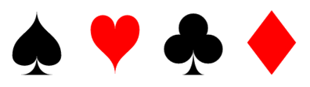

Deck of Cards Workout

Slide 2
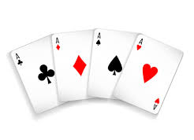
How to play
All you need for this activity is a deck of cards, if you don’t have one, here is your random deck of cards! Just click the deck to see your card. (Click shuffle after each card)
1. When you draw a card, you’ll complete an exercise.
2. Complete the number of repetitions shown on your card. For example, if you draw the 4 of hearts, perform 4 of the exercises shown on slide 6.
3. Picture cards (e.g. a king) are worth 10 repetitions (you do it 10 times). Aces are worth 11 repetitions.

Slide 3
How to play
You can play 1 of the following game modes-
Individual Challenge- Set a timer for 20 minutes and get through as many cards as possible in the deck. Take short rest breaks between activities of 10-15 seconds.
Household Challenge- Pick a member of the family and challenge them to mirror your exercises as you pick the cards out. Do as many as possible in 20 minutes.
Head to Head- Using the deck of cards, pick 1 card each with a member of the household and go head to head to see who completes 10 cards the fastest

Slide 4
Differentiation
You can do one of the following to make it easier/harder-
Race the deck- See if you can get through a whole deck of cards!
Design your own- Come up with your own exercises for each suit
Double up- Pick two cards at a time and add them together!

Slide 5
Exercises- See below to see what each suit represents
Spades Press ups | Hearts Sit ups | Clubs Squats | Diamonds Star Jumps

Slide 6
Good luck and let your teacher know how you get on!

